Slide 1
Tour Mining Script Explanation
The Script is written in Java Script language with the supported of many library from the Node framework.
Node allow community to use and create the package as they want and use it for development.
Famous library that used in this project such as ‘file system’ ‘Twit’ ‘@google/map’ ‘kuromoji’ ‘express’ ‘ejs’ ‘body-parser’ and mores
Code can be found at https://github.com/carymono/tour_mining and https://github.com/carymono/tags_mining

Slide 2
1. Mining the User Script
Using the Twitter API to get the User who seems to start traveling.
The result will target the user who travel and we will use the user later on for the tour generating method.

Slide 3
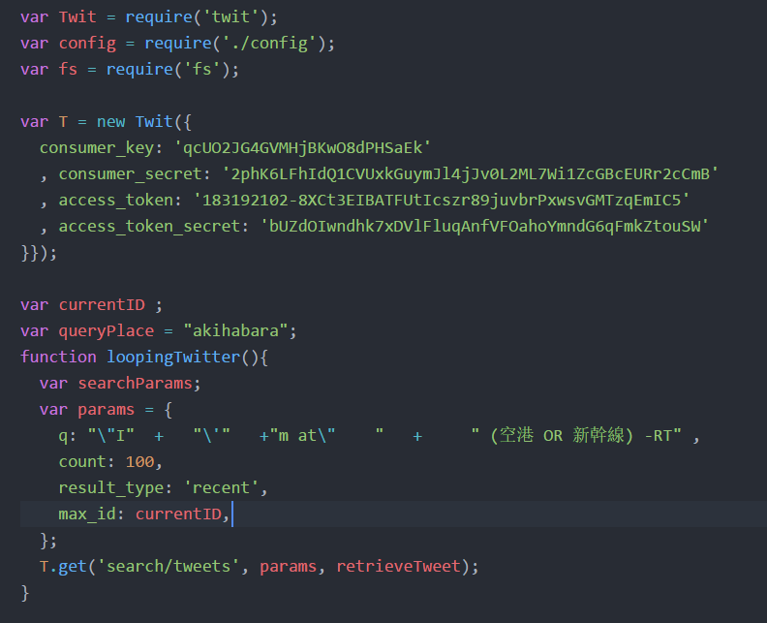
Using the Javascript’s Node framework to use the module created by the community for pulling twitter by using the require method.
Then input the API’s key in order to connect with the Twitter API
Configure the Parameter in order to specify what we want to search for
Finally, using the variable T which are the object from Twit node framework to generate API called with the callback function

Slide 4
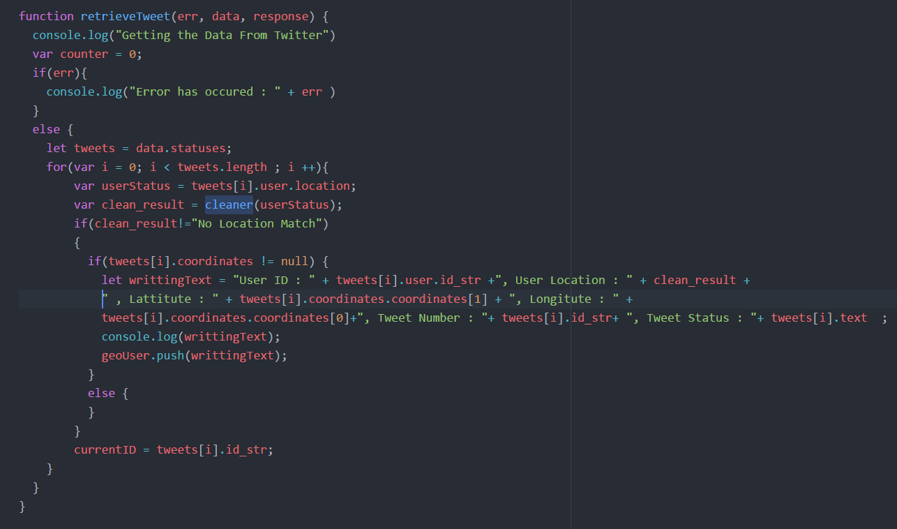
After the Tweets with specific parameter is collected, we then filter it with Geolocation and User’s Location.
User Location will be used as the start point of the traveling
The Geolocation will be used for Reverse-Geo-Coding method in order to specify user travelling location
The qualify tweet will be push into the array and will be write as the record later on.
The last line of code will save the last tweets from this process to continue looping over next 100 elements (this is because API limit only 100 elements per API call)

Slide 5
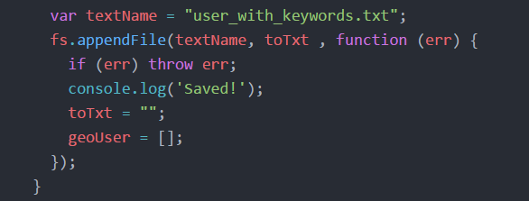
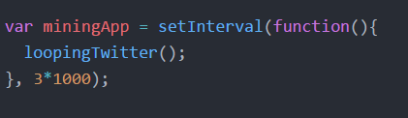
Finally the Array that collect all the result will be used to write the file.
After that the process continue to loop over next 100 twitters and so on.

Slide 6
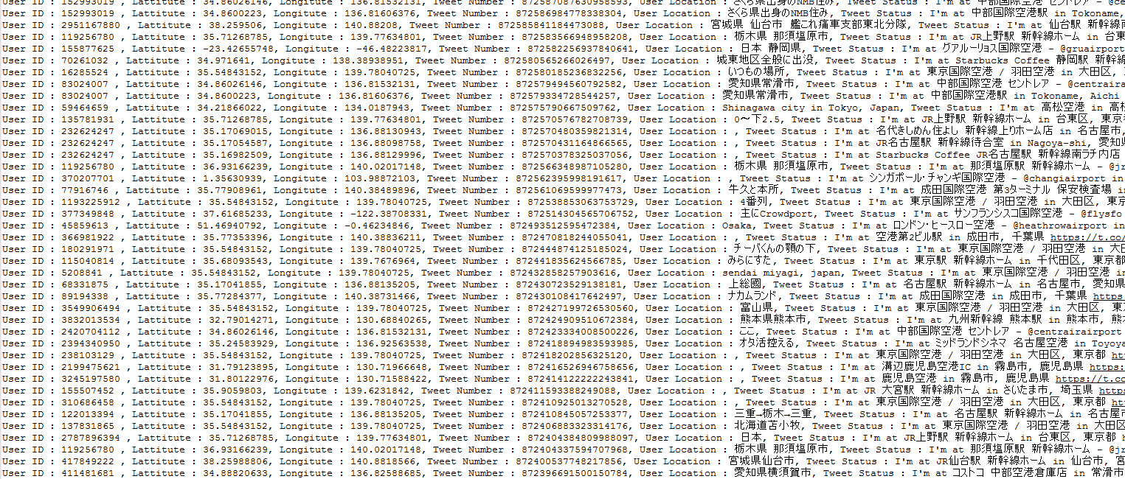
Example Output

Slide 7
2. User Timeline Script
Mining the user timeline since the selected tweeted from the User Script.
Go over last 900 tweets from the selected tweeted and collect the Geo Location from the tweet to generate tour record.

Slide 8
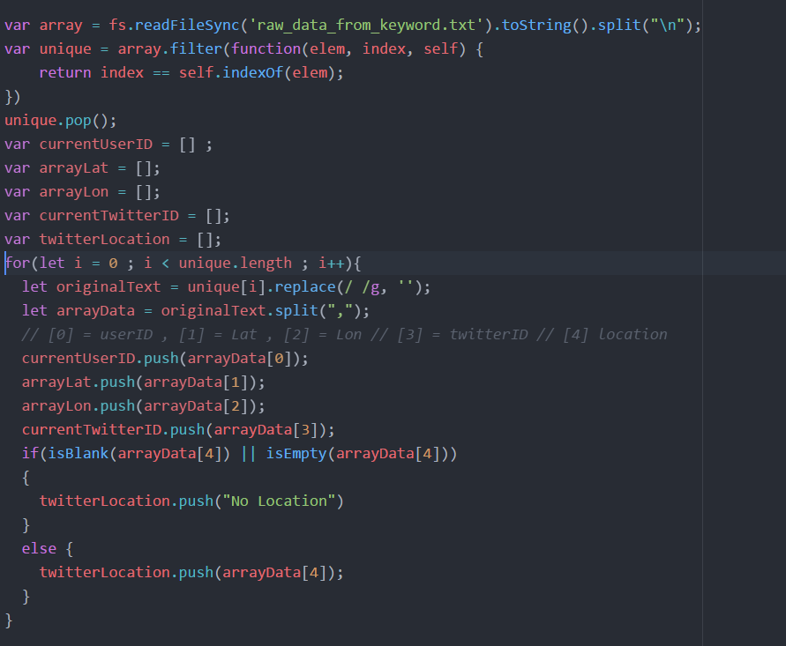
Read the user ID from the last text. Then store in the Array.
After that split the comma ‘,’ into and store each variable and stored it into the Array.
Also check if the User doesn’t have the location then put the place holder String as “No Location”

Slide 9
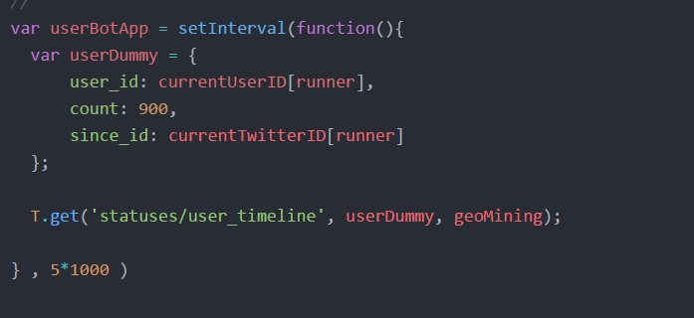
Then called the User API for each element in the User Array and search the timeline for that user for 900 tweets as the input parameter.

Slide 10
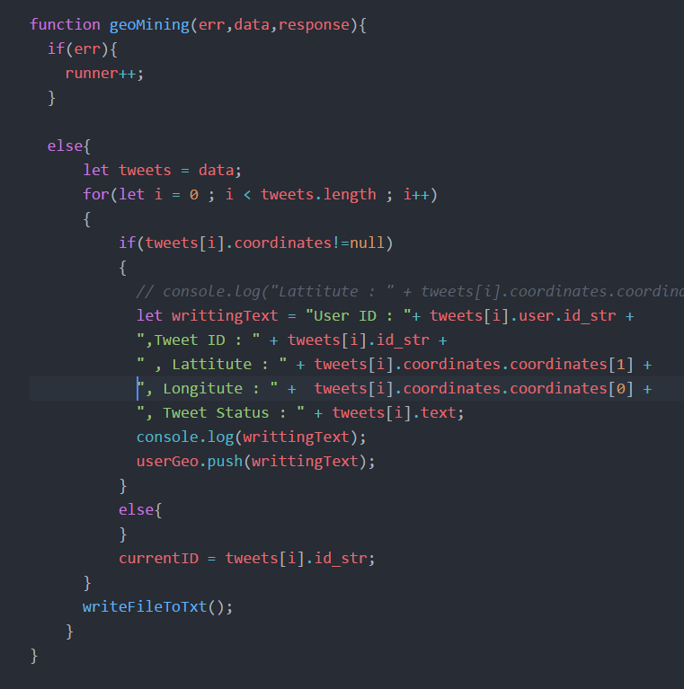
The call back function will check for the tweet geo location. If the geo location is presented then the tweets will be collected into the Array.
After the loop end(around 900 iteration), then script process with the writing function which will record the result into the text file.
Writing process is the same as last script.

Slide 11
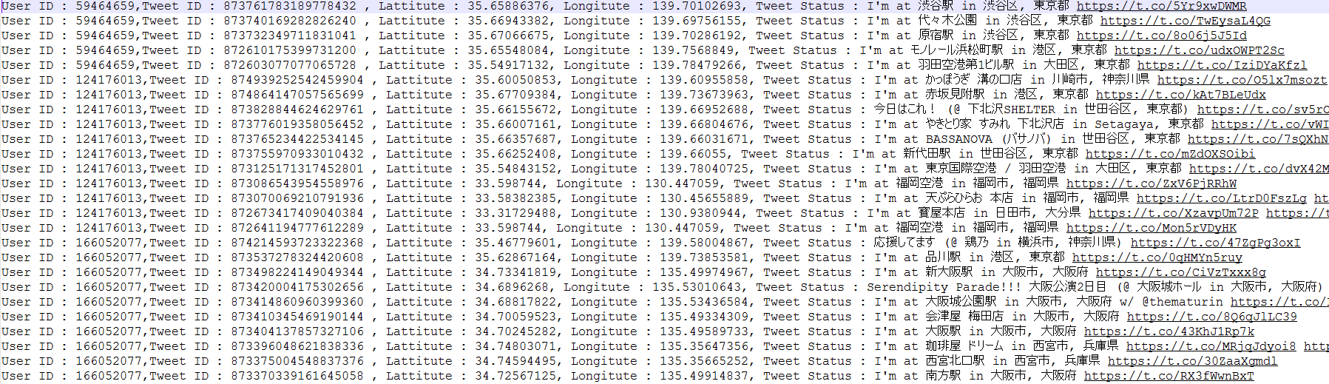
Example Output

Slide 12
3. Google Map API Script
Mapped the tweet’s geo location into the real world location in order to make it readable
Also clean the data to allow it to use in the database.
Finally connect the record together for putting it in the database.

Slide 13
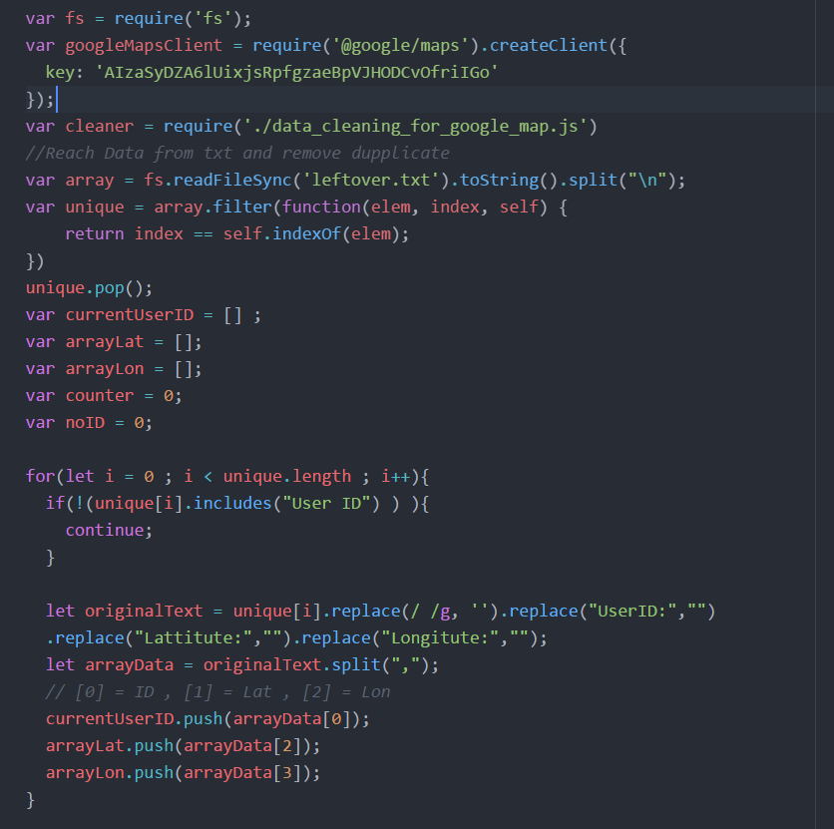
Start with the connecting the Google Map API from the Node package called @google/maps.
After that read the data from last script and split the data into different Array.

Slide 14
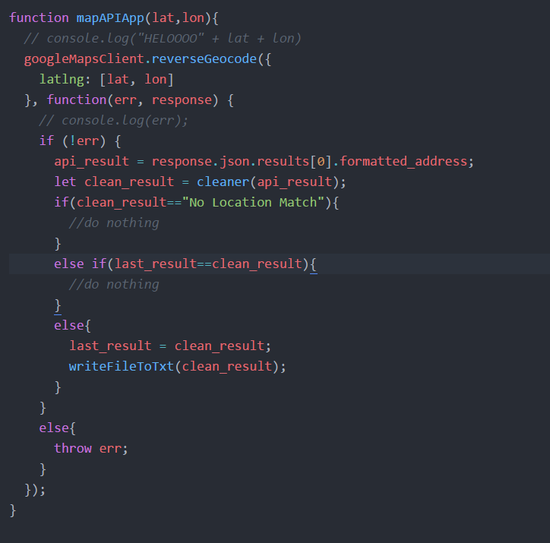
After that the program create the API called from the Latitude and Longitude from the user tweets.
After the location is received then it will go through the data cleaning script to extract only the prefecture location.
After the cleaning is complete then the record is written into the text file.

Slide 15
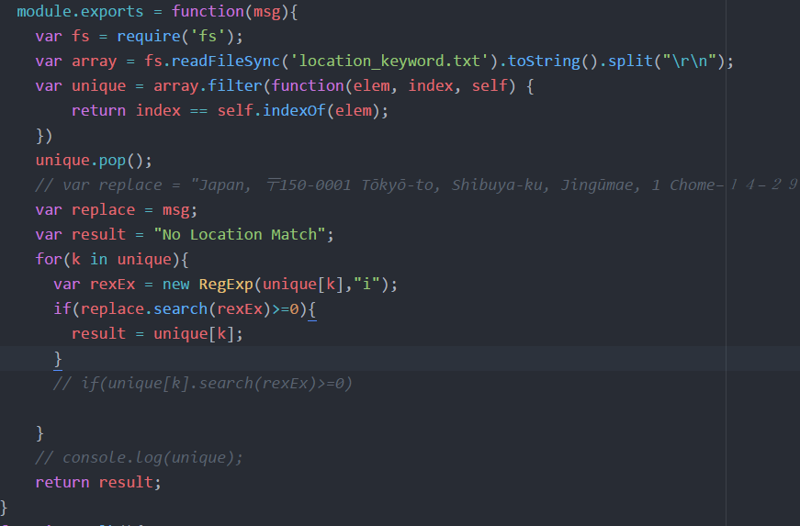
This is the cleaning script which take input from the Google Map API and mapped with the prefecture location text file
The script use Regular Expression in order to mapped the part of the location precisely.

Slide 16
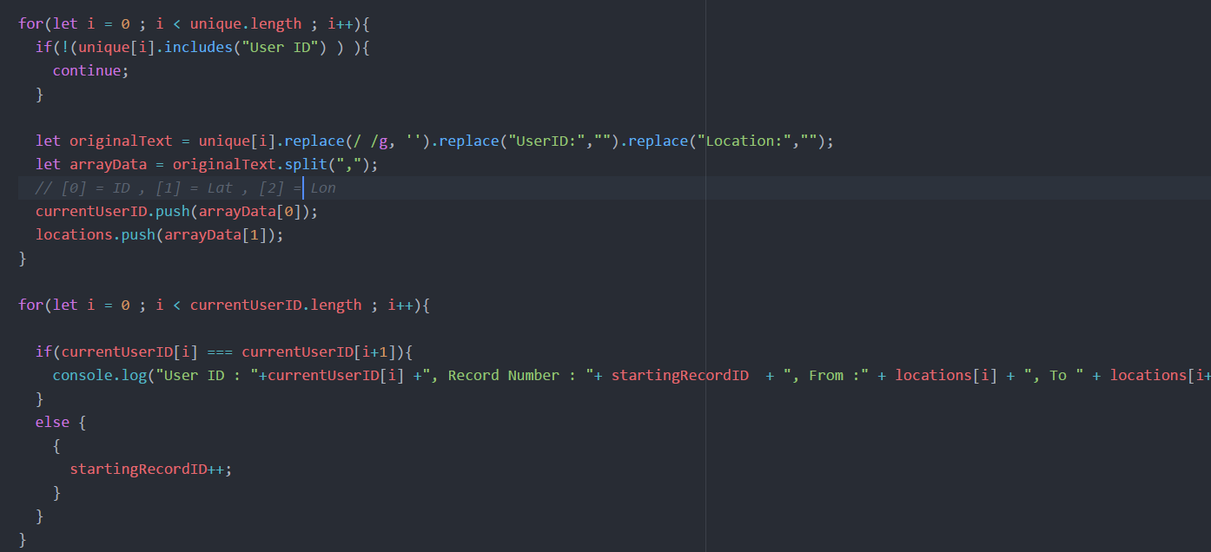
Finally, the tweet is combine into record for using easier to be put in the database for application.

Slide 17
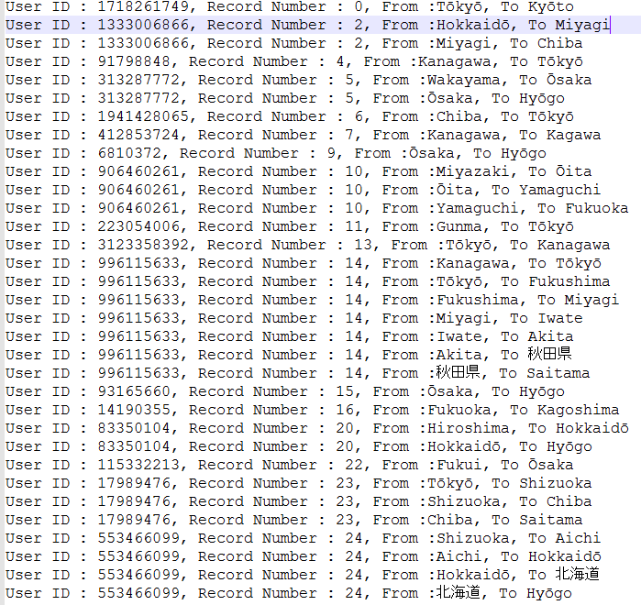
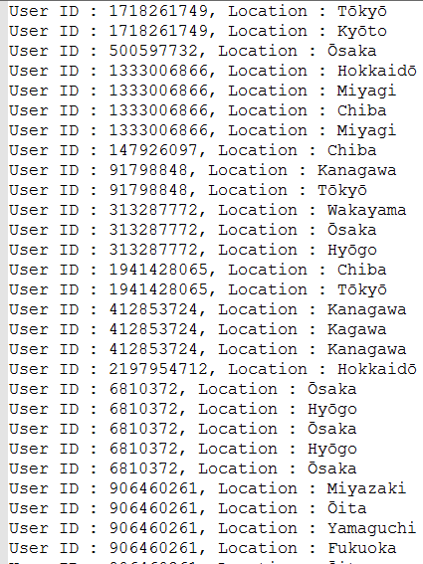
Example of the data from Google Map API
Example of the combining record

Slide 18
